Slide 1
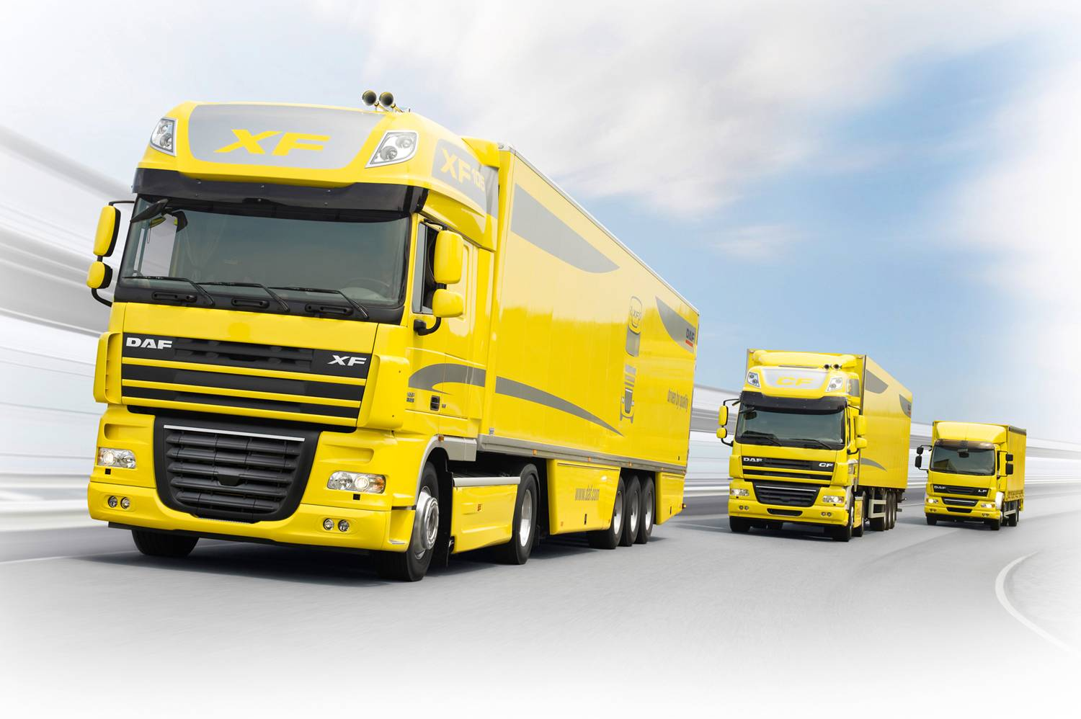


Slide 2
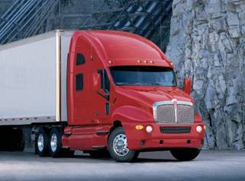
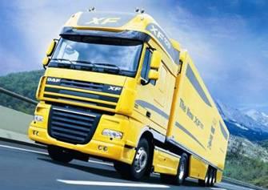
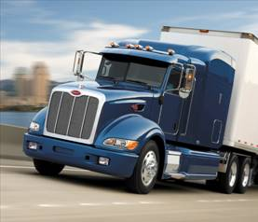
DAFTA Keywords in ControlDesk
Niels de Grooth

Slide 3


Slide 4
Outline
StartKeywordsInControlDesk.py aka Running man
Integration with ATI Vision → use arguments
XCP
J1939 monitor

Slide 5
Why?
Use the full power of test automation in Manual testing
Use functions not available on ControlDesk layout such as
Kwp
Tasks of mechanic: Report DTC’s / Clear DTC’s

Slide 6
To:
Quickly get some info on DTCs
Get the vehicle quickly in a certain state or at a speed
Driver.driveTo(vSpeed=50)
Driver.driveTo(gear=6, rpm=1200)
Quickly execute (some) test steps
Use XCP in manual tests

Slide 7
What?
ControlDesk
A2L with Vision strategy for
Reading/ changing A2L labels
XCP
PyScripter

Slide 8
Examples
Mechanic.reportDTCs()
Driver.driveTo(vSpeed=80)
Driver.stopTruck()
Kwp.readDataByLocalIdentifier(0x90)
Kwp.writeDataByLocalIdentifier(0x90, LID_DATA)
Mechanic. clearAllFaults()
Config.US13()
Engine.Controller.ACAN.RX.TESTRUN_INFO.TgId[231] = 3
Engine.Controller.ACAN.RX.TESTINHIBIT_INFO.TgId[231] = 1
Xcp.stim(‘Engine_speed, 666)
Xcp.stim(‘J1939cm_propb_dpf_lr_fault_data.F_Hard’, 1)

Slide 9
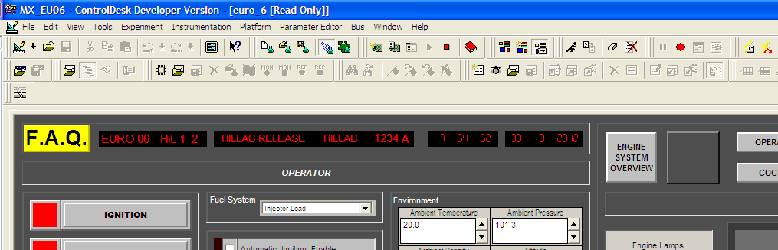
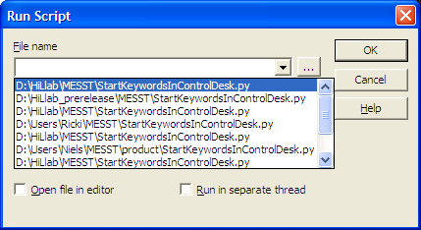
How? (ControlDesk)
In ControlDesk
D:\HiLlab\MESST\StartKeywordsInControlDesk.py

Slide 10
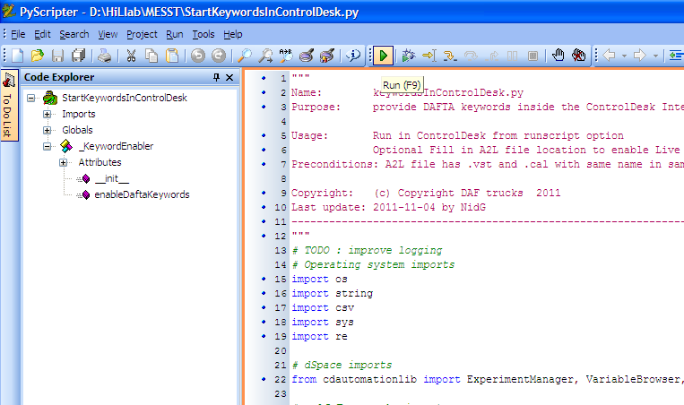
How? (PyScripter)
Open D:\HiLlab\MESST\StartKeywordsInControlDesk.py
Press the ‘play’ button:

Slide 11
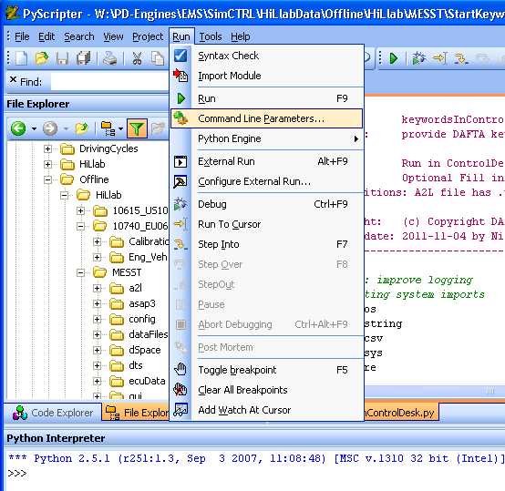
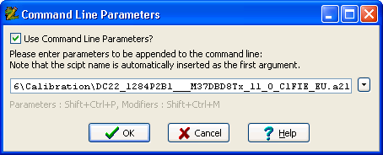
How? (PyScripter)

Slide 12
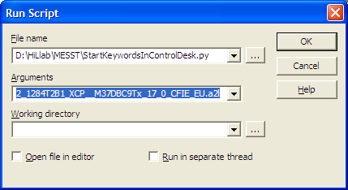
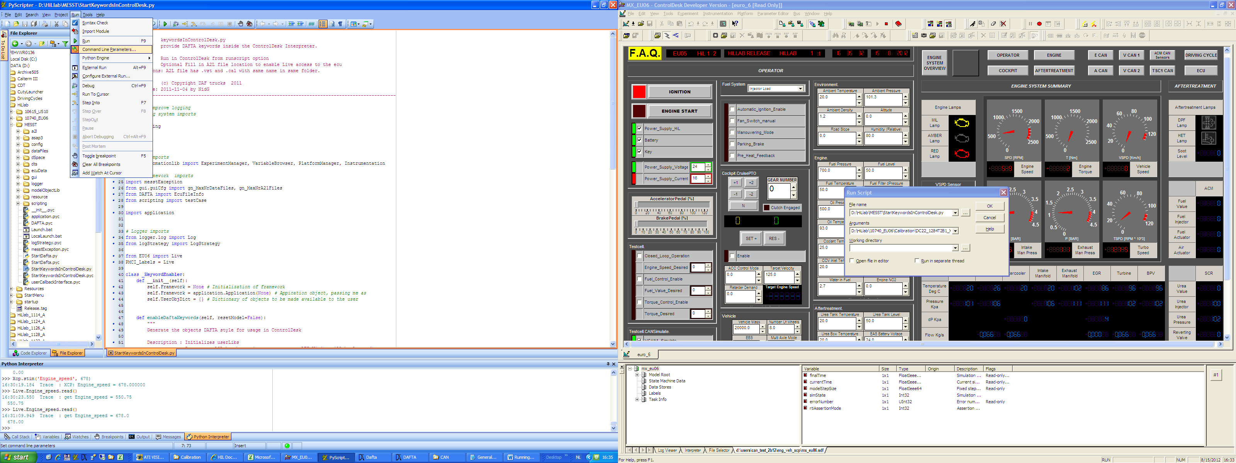
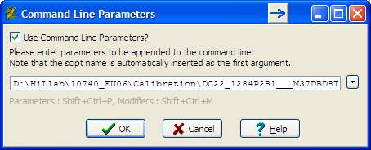
With A2L …
The path to the A2L file has to be given to the script as an argument:
Notes:
Note that ControlDesk keeps a history of file names. This can help to quickly select the file. Be careful, there may be files in the list that are development files, so only use released files.

